Slide 1
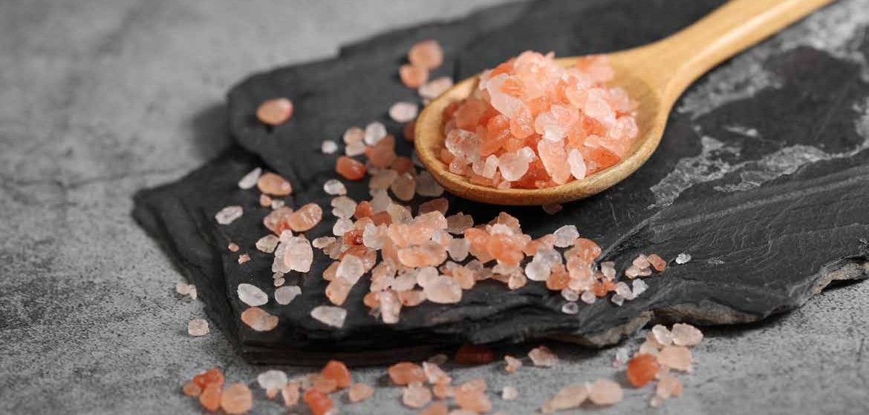
PRODUCT
CATALOGUE

Slide 2
Table Of Content
Product Catalogue
Welcome To AURA |  | Himalayan nimal Shape Lamps
Himalayan Pink Salt History |  | Himalayan Wooden & Iron Baskets
We Are Certified |  | Himalayan Fire Bowls
Himalayan Edible Salt |  | Himalayan White Salt Lamps
Food Grade Salt In Grinders |  | Himalayan Grey Salt Lamps
Food Grade Salt In Shakers |  | Himalayan U.S.B Lamps
Food Grade Salt In Pet Jars |  | Himalayan Night Light Lamps
Food Grade Salt In Pouches |  | Himalayan Candle Light Holders
Himalayan Seasoning Spices |  | Himalayan Health And Wellness
Seasoning Spices Flavours |  | Bath Salt & Body Scrubs
Himalayan Salt Lamps |  | Himalayan Kitchen Products
Himalayan Natural Lamps |  | Himalayan Animal Salt Products
Himalayan Handi - Craft Lamps |  | Himalayan Construction Products

Slide 3
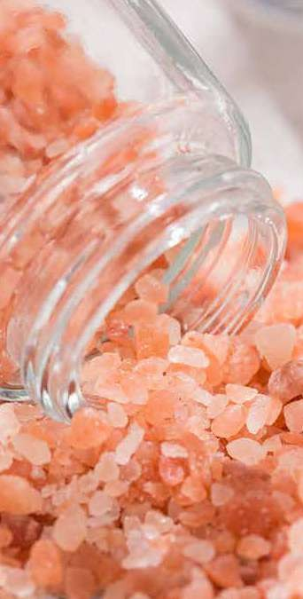
Welcome To
Product Catalogue
AURA is one of the largest and senior company supplying and exporting Himalayan mineral rock salt product in Pakistan. AURA is exporting this got gifted Himalayan mineral rock salt products to united states, Central and south America, United Kingdom, Euripean Countries & Far East etc.

Slide 4
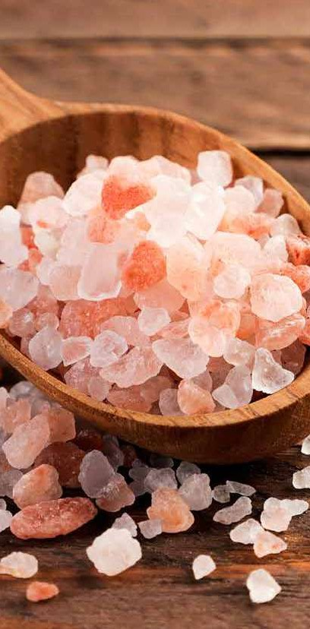


AURA NATIONAL Himalayan Pink Salt History
Product Catalogue

Slide 5
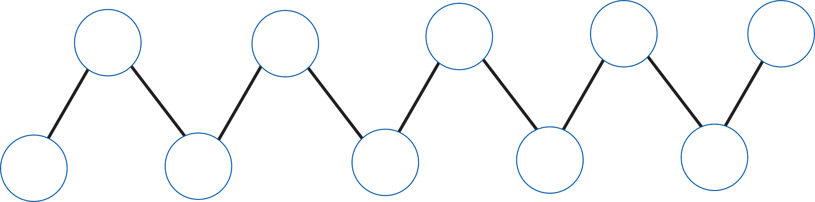










Certified Manufacturer & Exporters
Of AURA NATURAL HIMALAYAN PINK SALT
Product Catalogue
Our commitment to honesty, integrity, and respect for laws and regulations forms the foundation of our adherence to all legally recognized and legitimate privacy laws worldwide within the AURA Natural Himalayan Pink Salt industry.
KOSHER
BRC
ISO 14001:2015
GMP
HACCP
ORGANIC
FDA
ISO 9001:2015
ISO 22000:2018
PCSIR

Slide 6
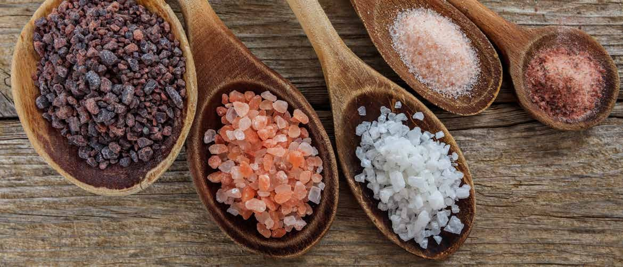
aura Edible Salt
Product Catalogue
Aura Edible Salt is unique in taste, texture, & color. It is ethically sourced
from the Hiamalayan Mountains. It is natural, Unprocessed, and free of additives, dyes, and preservatives.

Slide 7
Product Catalogue
Food Grade
Salt In Grinders
Grind with Precision,
Season with Himalayan Elegance.

Slide 8









PRODUCT DETAIL
Product Catalogue
Glass Grinders
200 gm / 7.05 oz.
200 gm / 7.05 oz.
200 gm / 7.05 oz.
Light Pink | Dark Pink | Black | White | Light Pink | Dark Pink | Black | White | Light Pink | Dark Pink | Black | White
SKU : | SKU : | SKU : | SKU : | SKU : | SKU : | SKU : | SKU : | SKU : | SKU : | SKU : | SKU :
GG - 01 | GG - 02 | GG - 03 | GG - O4
GG - 05 | GG - 06 | GG - 07 | GG - O8
GG - 09 | GG - 10 | GG - 11 | GG - 12

Slide 9








PRODUCT DETAIL
Product Catalogue
Glass Grinders
200 gm / 7.05 oz.
120 gm / 4.23 oz.
120 gm / 4.23 oz.
Light Pink | Dark Pink | Black | White | Light Pink | Dark Pink | Black | White | Light Pink | Dark Pink | Black | White
SKU : | SKU : | SKU : | SKU : | SKU : | SKU : | SKU : | SKU : | SKU : | SKU : | SKU : | SKU :
GG - 13 | GG - 14 | GG - 15 | GG - 16
GG - 17 | GG - 18 | GG - 19 | GG - 20
GG - 21 | GG - 22 | GG - 23 | GG - 24

Slide 10





PRODUCT DETAIL
Product Catalogue
Plastic Grinders
110 gm / 3.8 oz.
240 gm / 8.4 oz.
480 gm / 16.9 oz.
Light Pink | Dark Pink | Black | White | Light Pink | Dark Pink | Black | White | Light Pink | Dark Pink | Black | White
SKU : | SKU : | SKU : | SKU : | SKU : | SKU : | SKU : | SKU : | SKU : | SKU : | SKU : | SKU :
PG - 01 | PG - 02 | PG - 03 | PG - O4
PG - 05 | PG - 06 | PG - 07 | PG - O8
PG - 09 | PG - 10 | PG - 11 | PG - 12

Slide 11
Food Grade Salt In Shakers
Shake on the goodness of Himalayan minerals.
Product Catalogue

Slide 12







PRODUCT DETAIL
Product Catalogue
Plastic Shakers
250 gm / 8.81 oz.
285 gm / 10.05 oz.
425 gm / 14.99 oz.
Light Pink | Dark Pink | Black | White | Light Pink | Dark Pink | Black | White | Light Pink | Dark Pink | Black | White
SKU : | SKU : | SKU : | SKU : | SKU : | SKU : | SKU : | SKU : | SKU : | SKU : | SKU : | SKU :
PS - 01 | PS - 02 | PS - 03 | PS - O4
PS - 05 | PS - 06 | PS - 07 | PS - O8
PS - 09 | PS - 10 | PS - 11 | PS - 12

Slide 13




PRODUCT DETAIL
Product Catalogue
Plastic Shakers
500 gm / 17.63 oz.
800 gm / 28.21 oz.
1000 gm / 35.27 oz.
Light Pink | Dark Pink | Black | White | Light Pink | Dark Pink | Black | White | Light Pink | Dark Pink | Black | White
SKU : | SKU : | SKU : | SKU : | SKU : | SKU : | SKU : | SKU : | SKU : | SKU : | SKU : | SKU :
PS - 13 | PS - 14 | PS - 15 | PS - 16
PS - 17 | PS - 18 | PS - 19 | PS - 20
PS - 21 | PS - 22 | PS - 23 | PS - 24

Slide 14

PRODUCT DETAIL
Product Catalogue
Plastic Shakers
140 gm / 4.93 oz.
455 gm / 16.04 oz.
880 gm / 31.04 oz.
Light Pink | Dark Pink | Black | White | Light Pink | Dark Pink | Black | White | Light Pink | Dark Pink | Black | White
SKU : | SKU : | SKU : | SKU : | SKU : | SKU : | SKU : | SKU : | SKU : | SKU : | SKU : | SKU :
PS - 25 | PS - 26 | PS - 27 | PS - 28
PS - 29 | PS - 30 | PS - 31 | PS - 32
PS - 33 | PS - 34 | PS - 35 | PS - 36

Slide 15
Food Grade
Salt In Pet Jars
Product Catalogue
Fill your shelves with the Essence of the Himalayan Jars

Slide 16







PRODUCT DETAIL
Product Catalogue
Plastic Jars
500 gm / 17.06 oz.
1 kg / 35.2 oz.
2 kg / 70.5 oz.
Light Pink | Dark Pink | Black | White | Light Pink | Dark Pink | Black | White | Light Pink | Dark Pink | Black | White
SKU : | SKU : | SKU : | SKU : | SKU : | SKU : | SKU : | SKU : | SKU : | SKU : | SKU : | SKU :
Fine Grain | PJ - 01 | PJ - 02 | PJ - 03 | PJ - 04
Coarse | PJ - 05 | PJ - 06 | PJ - 07 | PJ - 08
Fine Grain | PJ - 09 | PJ - 10 | PJ - 11 | PJ - 12
Coarse | PJ - 13 | PJ - 14 | PJ - 15 | PJ - 16
Fine Grain | PJ - 17 | PJ - 18 | PJ - 19 | PJ - 20
Coarse | PJ - 21 | PJ - 22 | PJ - 23 | PJ - 24

Slide 17




PRODUCT DETAIL
Product Catalogue
Plastic Jars
500 gm / 17.06 oz.
1 kg / 35.2 oz.
Light Pink | Dark Pink | Black | White | Light Pink | Dark Pink | Black | White
SKU : | SKU : | SKU : | SKU : | SKU : | SKU : | SKU : | SKU :
Fine Grain | PJ - 25 | PJ - 26 | PJ - 27 | PJ - 28
Coarse | PJ - 29 | PJ - 30 | PJ - 31 | PJ - 32
Fine Grain | PJ - 33 | PJ - 34 | PJ - 35 | PJ - 36
Coarse | PJ - 37 | PJ - 38 | PJ - 39 | PJ - 40

Slide 18
Food Grade
Salt In Pouches
Product Catalogue
Experience the Himalayas on-the-go With Our Pouches.

Slide 19









Product Catalogue
Bulk Package
1 kg / 35.2 oz.
25 kg / 35.2 oz.
50 kg / 35.2 oz.
Light Pink | Dark Pink | Black | White | Light Pink | Dark Pink | Black | White | Light Pink | Dark Pink | Black | White
SKU : | SKU : | SKU : | SKU : | SKU : | SKU : | SKU : | SKU : | SKU : | SKU : | SKU : | SKU :
Fine | BP - 01 | BP - 02 | BP - 03 | BP - 04
Coarse | BP - 05 | BP - 06 | BP - 07 | BP - 08
Fine Coarse | BP - 09 | BP - 10 | BP - 11 | BP - 12
 | BP - 13 | BP - 14 | BP - 15 | BP - 16
Fine Coarse | BP - 17 | BP - 18 | BP - 19 | BP - 20
 | BP - 21 | BP - 22 | BP - 23 | BP - 24

Slide 20
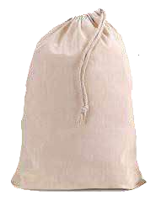




PRODUCT DETAIL
Product Catalogue
Cotton Bags
500 gm / 17.06 oz.
1 kg / 35.2 oz.
Light Pink | Dark Pink | Black | White | Light Pink | Dark Pink | Black | White
SKU : | SKU : | SKU : | SKU : | SKU : | SKU : | SKU : | SKU :
Fine Grain | CB - 01 | CB - 02 | CB - 03 | CB - 04
Coarse | CB - 05 | CB - 07 | CB - 08 | CB - 09
Fine Grain | CB - 10 | CB - 11 | CB - 12 | CB - 13
Coarse | CB - 14 | CB - 15 | CB - 16 | CB - 17

Slide 21
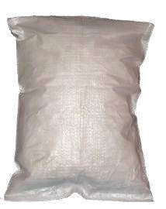
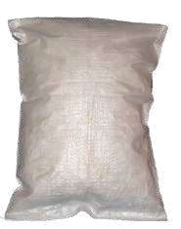


PRODUCT DETAIL
Product Catalogue
Cotton Bags
25 Kg / 881.8 oz.
30 kg / 1058.2 oz.
Light Pink | Dark Pink | Black | White | Light Pink | Dark Pink | Black | White
SKU : | SKU : | SKU : | SKU : | SKU : | SKU : | SKU : | SKU :
Fine Grain | CB - 18 | CB - 19 | CB - 20 | CB - 22
Coarse | CB - 23 | CB - 24 | CB - 25 | CB - 26
Fine Grain | CB - 27 | CB - 28 | CB - 29 | CB - 30
Coarse | CB - 31 | CB - 32 | CB - 33 | CB - 34

Slide 22









PRODUCT DETAIL
Product Catalogue
Standy Pouches
Printed
Printed
Printed
450 gm / 15.8 oz.
950 gm / 33.5 oz.
1.2 kg / 42.3 oz.
Light Pink
SKU :
Dark Pink
SKU :
Black
SKU :
White
SKU :
Light Pink
SKU :
Dark Pink
SKU :
Black
SKU :
White
SKU :
Light Pink
SKU :
Dark Pink
SKU :
Black
SKU :
White
SKU :
 | SPP - 01 | SPP - 02 | SPP - 03 | SPP - 04
 | SPP - 05 | SPP - 06 | SPP - 07 | SPP - 08
 | SPP - 09 | SPP - 10 | SPP - 11 | SPP - 12
 | SPP - 13 | SPP - 14 | SPP - 15 | SPP - 16
 | SPP - 17 | SPP - 18 | SPP - 19 | SPP - 20
 | SPP - 21 | SPP - 22 | SPP - 23 | SPP - 24
Fine
Fine
Fine
Coarse
Coarse
Coarse

Slide 23



PRODUCT DETAIL
Product Catalogue
Standy Pouches
Transparent
Transparent
Transparent
450 gm / 15.8 oz.
950 gm / 33.5 oz.
1.2 kg / 42.3 oz.
Light Pink
SKU :
Dark Pink
SKU :
Black
SKU :
White
SKU :
Light Pink
SKU :
Dark Pink
SKU :
Black
SKU :
White
SKU :
Light Pink
SKU :
Dark Pink
SKU :
Black
SKU :
White
SKU :
 | SPT - 01 | SPT - 02 | SPT - 03 | SPT - 04
 | SPT - 05 | SPT - 06 | SPT - 07 | SPT - 08
 | SPT - 09 | SPT - 10 | SPT - 11 | SPT - 12
 | SPT - 13 | SPT - 14 | SPT - 15 | SPT - 16
 | SPT - 17 | SPT - 18 | SPT - 19 | SPT - 20
 | SPT - 21 | SPT - 22 | SPT - 23 | SPT - 24
Fine
Fine
Fine
Coarse
Coarse
Coarse

Slide 24




PRODUCT DETAIL
Product Catalogue
Box Pouches
Printed
Printed
Printed
500 gm / 17.6 oz.
1 kg / 35.2 oz.
1.2 kg / 42.3 oz.
Light Pink
SKU #
Dark Pink
SKU #
Black
SKU #
White
SKU #
Light Pink
SKU #
Dark Pink
SKU #
Black
SKU #
White
SKU #
Light Pink
SKU #
Dark Pink
SKU #
Black
SKU #
White
SKU #
 | BPP - 01 | BPP - 02 | BPP - 03 | BPP - 04
 | BPP - 05 | BPP - 06 | BPP - 07 | BPP - 08
 | BPP - 09 | BPP - 10 | BPP - 11 | BPP - 12
 | BPP - 13 | BPP - 14 | BPP - 15 | BPP - 16
 | BPP - 17 | BPP - 18 | BPP - 19 | BPP - 20
 | BPP - 21 | BPP - 22 | BPP - 23 | BPP - 24
Fine
Fine
Fine
Coarse
Coarse
Coarse

Slide 25
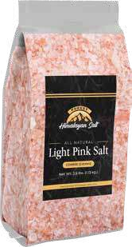
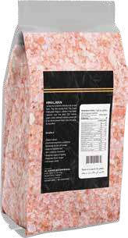


PRODUCT DETAIL
Product Catalogue
Box Pouches
Transparent
Transparent
Transparent
500 gm / 17.6 oz.
1 kg / 35.2 oz.
1.2 kg / 42.3 oz.
Light Pink
SKU #
Dark Pink
SKU #
Black
SKU #
White
SKU #
Light Pink
SKU #
Dark Pink
SKU #
Black
SKU #
White
SKU #
Light Pink
SKU #
Dark Pink
SKU #
Black
SKU #
White
SKU #
 | BPT - 01 | BPT - 02 | BPT - 03 | BPT - 04
 | BPT - 05 | BPT - 06 | BPT - 07 | BPT - 08
 | BPT - 09 | BPT - 10 | BPT - 11 | BPT - 12
 | BPT - 13 | BPT - 14 | BPT - 15 | BPT - 16
 | BPT - 17 | BPT - 18 | BPT - 19 | BPT - 20
 | BPT - 21 | BPT - 22 | BPT - 23 | BPT - 24
Fine
Fine
Fine
Coarse
Coarse
Coarse

Slide 26
PRODUCT DETAIL
Product Catalogue
Pillow Pouches
Printed
Printed
Printed
400 gm / 14.1 oz.
800 gm / 28.2 oz.
1 kg / 35.2 oz.
Light Pink
SKU :
Dark Pink
SKU :
Black
SKU :
White
SKU :
Light Pink
SKU :
Dark Pink
SKU :
Black
SKU :
White
SKU :
Light Pink
SKU :
Dark Pink
SKU :
Black
SKU :
White
SKU :
 | PPP - 01 | PPP - 02 | PPP - 03 | PPP - 04
 | PPP - 05 | PPP - 06 | PPP - 07 | PPP - 08
 | PPP - 09 | PPP - 10 | PPP - 11 | PPP - 12
 | PPP - 13 | PPP - 14 | PPP - 15 | PPP - 16
 | PPP - 17 | PPP - 18 | PPP - 19 | PPP - 20
 | PPP - 21 | PPP - 22 | PPP - 23 | PPP - 24
Fine
Fine
Fine
Coarse
Coarse
Coarse

Slide 27



Product Catalogue
Pillow Pouches
Transparent
Transparent
Transparent
400 gm / 14.1 oz.
800 gm / 28.2 oz.
1 kg / 35.2 oz.
Light Pink
SKU :
Dark Pink
SKU :
Black
SKU :
White
SKU :
Light Pink
SKU :
Dark Pink
SKU :
Black
SKU :
White
SKU :
Light Pink
SKU :
Dark Pink
SKU :
Black
SKU :
White
SKU :
 | PPT - 01 | PPT - 02 | PPT - 03 | PPT - 04
 | PPT - 05 | PPT - 06 | PPT - 07 | PPT - 08
 | PPT - 09 | PPT - 10 | PPT - 11 | PPT - 12
 | PPT - 13 | PPT - 14 | PPT - 15 | PPT - 16
 | PPT - 17 | PPT - 18 | PPT - 19 | PPT - 20
 | PPT - 21 | PPT - 22 | PPT - 23 | PPT - 24
Fine
Fine
Fine
Coarse
Coarse
Coarse

Slide 28
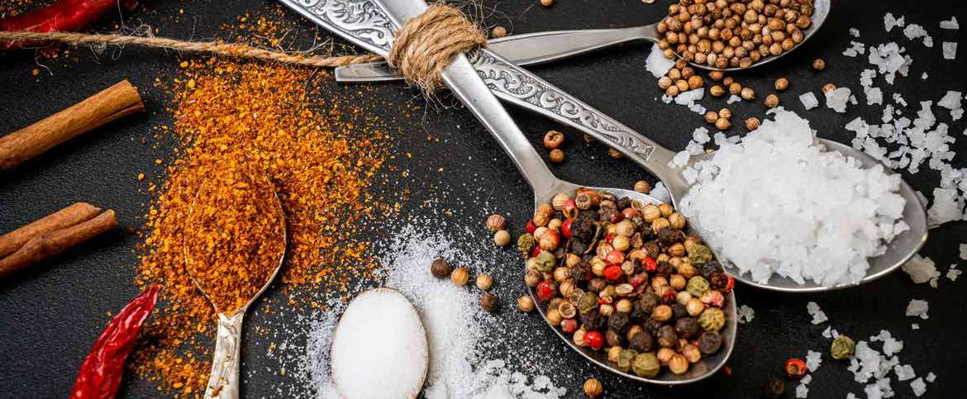
Himalayan Seasoning Spices
Product Catalogue
Infuse your cooking with the unparalleled purity of Himalayan pink salt spices, sourced from the majestic Himalayan mountains. Delight in the rich complexity of flavors as the salt crystals mingle with a carefully curated selection of herbs and spices, transforming every dish into a culinary masterpiece.

Slide 29
Salt Seasoning Spices
Unlock the rich flavors of the Himalayas with our Seasoning Spices.
Product Catalogue

Slide 30
Seasoning Spices
Product Catalogue
PRODUCT DETAIL
PRODUCT DETAIL
PRODUCT DETAIL
PRODUCT DETAIL
PRODUCT DETAIL
Flavour
Flavour
Flavour
Flavour
Flavour
Lemon Grass
Oregano
Garlic
Rosemary
Thyme
Pet Shaker 250 gm / 8.8 oz.
Pet Shaker 250 gm / 8.8 oz.
Pet Shaker 250 gm / 8.8 oz.
Pet Shaker 250 gm / 8.8 oz.
Pet Shaker 250 gm / 8.8 oz.

Slide 31
Seasoning Spices
Product Catalogue
PRODUCT DETAIL
PRODUCT DETAIL
PRODUCT DETAIL
PRODUCT DETAIL
PRODUCT DETAIL
Flavour
Flavour
Flavour
Flavour
Flavour
Red Chilli
Paprika
Chilli Flakes
Volcano
Black Pepper
Pet Shaker 250 gm / 8.8 oz.
Pet Shaker 250 gm / 8.8 oz.
Pet Shaker 250 gm / 8.8 oz.
Pet Shaker 250 gm / 8.8 oz.
Pet Shaker 250 gm / 8.8 oz.

Slide 32
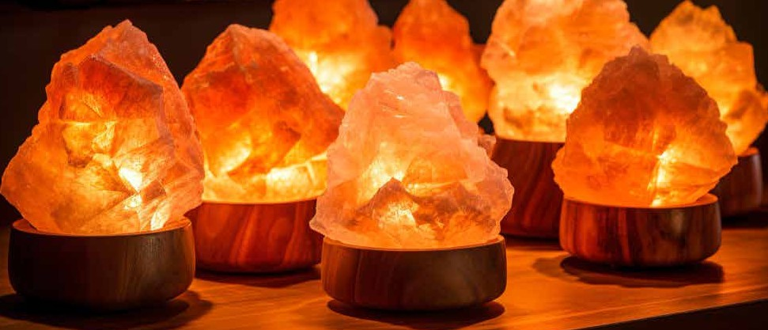
Aura Lamps
Product Catalogue
Aura is 100% pure, unscented, untreated and a gift of nature to human beings.
This Aura is a marvelous dietary supplement that looks and tastes fantastic.
It is rich in trace minerals and it’s mined from underground seams of salt deposits in the
unpollutted foothills of the Himalayan Mountains.

Slide 33
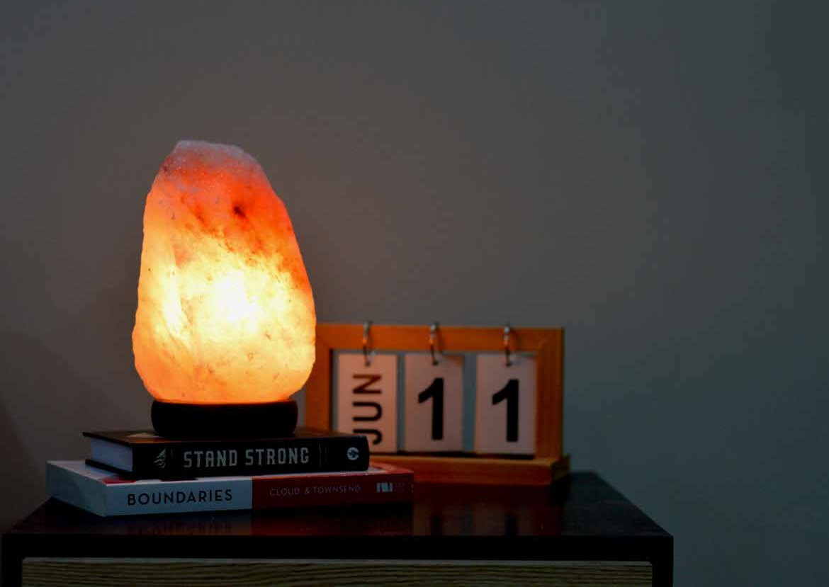
Aura Natural Shape Lamps
Product Catalogue
Light up your life with the calming energy of
Aura Natural Lamps

Slide 34
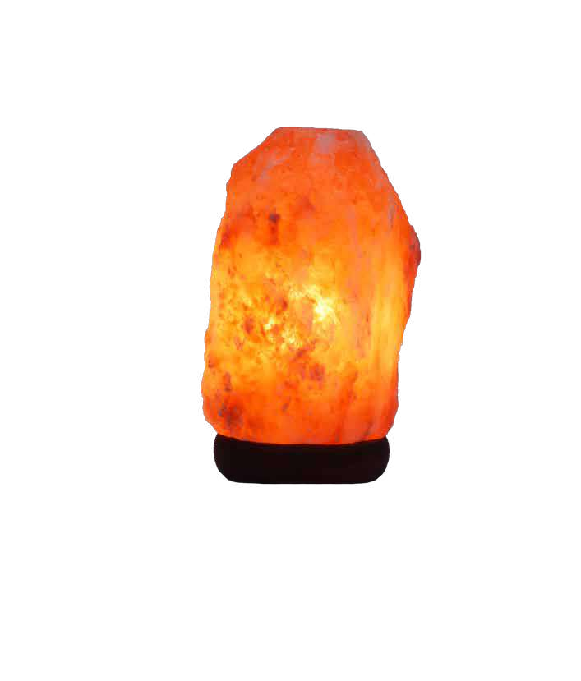
PRODUCT DETAIL
Product Catalogue
Natural Dark Pink
Salt Lamp
Electrical Accessory Includes
Switch: On/Off Dimmer Available
Volts: 110/220
Cord Lenght: 6 Feet
Bulb: E12 - 15 Watts
LAMP SIZES | SKU No:
1 to 2 kg | NDL - 01
2 to 3 kg | NDL - 02
3 to 5 kg | NDL - 03
5 to 7 kg | NDL - 04
7 to 9 kg | NDL - 05
9 to 12 kg | NDL - 06
12 to 15 kg | NDL - 07
15 to 20 kg | NDL - 08
20 to 25 kg | NDL - 09
25 to 30 kg | NDL - 10
30 to 40 kg | NDL - 11
40 to 50 kg | NDL - 12
On Demand:
Any shape and size can be produced
Lamps base: Wooden, Marble & Plastic feet are available
Private labels / brand can be placed

Slide 35
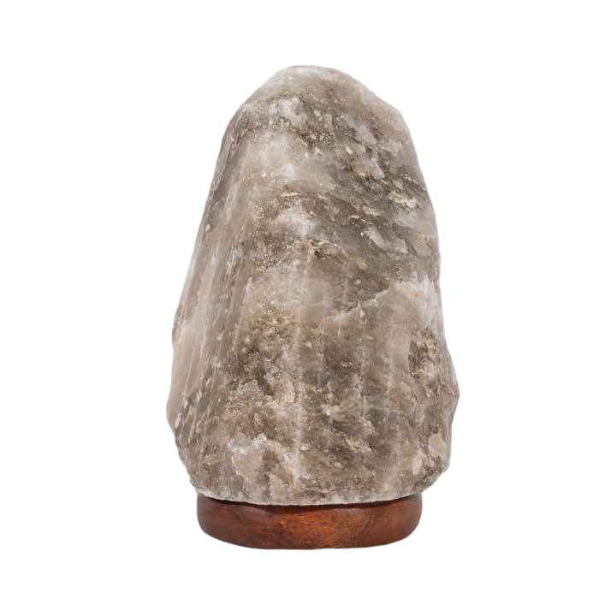
PRODUCT DETAIL
Product Catalogue
Natural Gray
Salt Lamp
Electrical Accessory Includes
Switch: On/Off Dimmer Available
Volts: 110/220
Cord Lenght: 6 Feet
Bulb: E12 - 15 Watts
LAMP SIZES | SKU No:
1 to 2 kg | NGL - 01
2 to 3 kg | NGL - 02
3 to 5 kg | NGL - 03
5 to 7 kg | NGL - 04
7 to 9 kg | NGL - 05
9 to 12 kg | NGL - 06
12 to 15 kg | NGL - 07
15 to 20 kg | NGL - 08
20 to 25 kg | NGL - 09
25 to 30 kg | NGL - 10
30 to 40 kg | NGL - 11
40 to 50 kg | NGL - 12
On Demand:
Any shape and size can be produced
Lamps base: Wooden, Marble & Plastic feet are available
Private labels / brand can be placed
Page 001

Slide 36
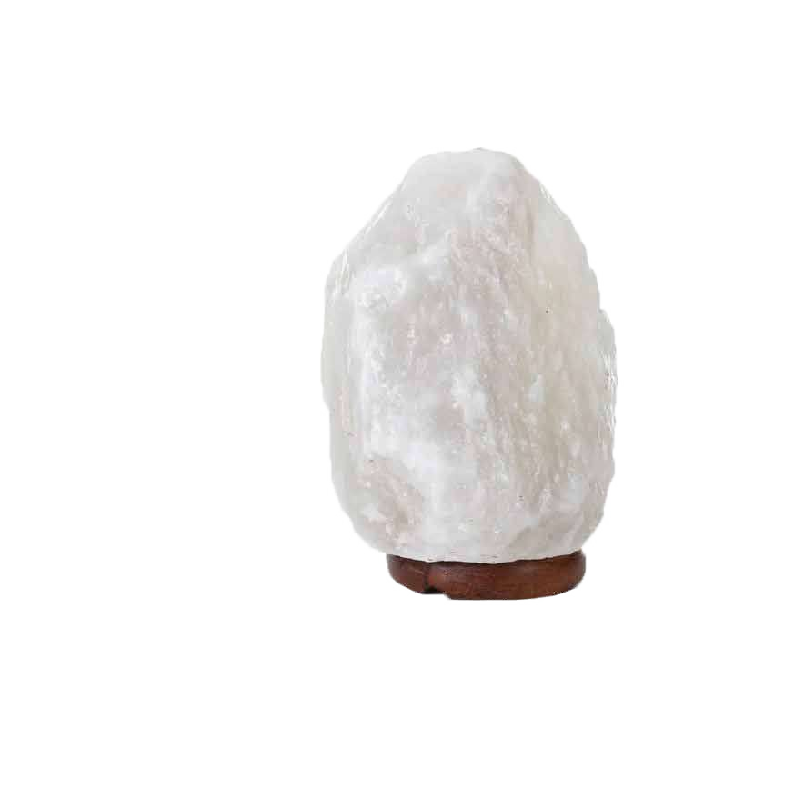
PRODUCT DETAIL
Product Catalogue
Natural White
Salt Lamp
Electrical Accessory Includes
Switch: On/Off Dimmer Available
Volts: 110/220
Cord Lenght: 6 Feet
Bulb: E12 - 15 Watts
LAMP SIZES | SKU No:
1 to 2 kg | NWL - 01
2 to 3 kg | NWL - 02
3 to 5 kg | NWL - 03
5 to 7 kg | NWL - 04
7 to 9 kg | NWL - 05
9 to 12 kg | NWL - 06
12 to 15 kg | NWL - 07
15 to 20 kg | NWL - 08
20 to 25 kg | NWL - 09
25 to 30 kg | NWL - 10
30 to 40 kg | NWL - 11
40 to 50 kg | NWL - 12
On Demand:
Any shape and size can be produced
Lamps base: Wooden, Marble & Plastic feet are available
Private labels / brand can be placed
Page 001

Slide 37

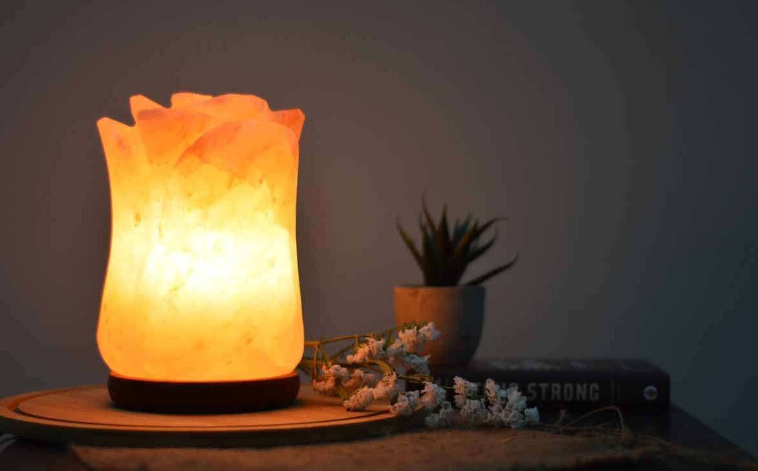
Product Catalogue
Aura
Handi Craft
Lamps
Light up your life with the calming energy of
Aura Natural Lamps

Slide 38
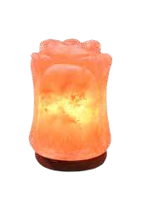
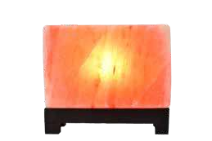
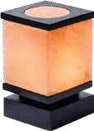
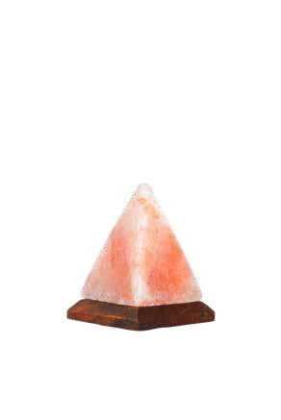
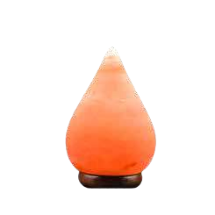
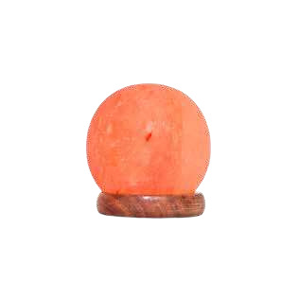
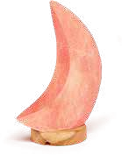
Product Catalogue
Rose Flower Lamp
Rectangle Lamp
Square Shape Lamp
Cylinder Shape Lamp
SKU: HCL - 01
SKU: HCL - 02
SKU: HCL - 03
SKU: HCL - 04
Moon Shape Lamp
Pyramid Shape Lamp
Tear Drop Lamp
Ball Shape Lamp
SKU: HCL - 05
SKU: HCL - 06
SKU: HCL - 07
SKU: HCL - 08

Slide 39
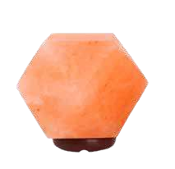
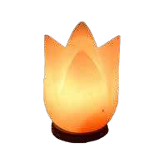
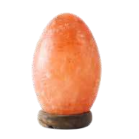
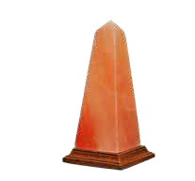
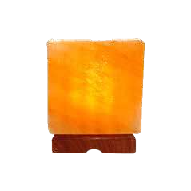
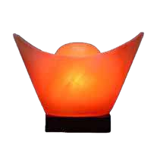
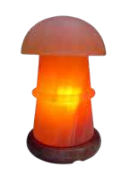
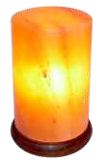
Product Catalogue
Diamond Shape Lamp
Lotus Flower Lamp
Egg Shape Lamp
Heart Shape Lamp
SKU: HCL - 09
SKU: HCL - 10
SKU: HCL - 11
SKU: HCL - 12
Sqaure Shape Lamp
Chinese Gold Lamp
Mushroom Lamp
Cylinder Lamp
SKU: HCL - 13
SKU: HCL - 14
SKU: HCL - 15
SKU: HCL - 16

Slide 40
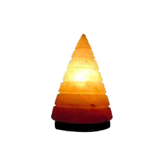
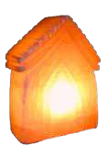
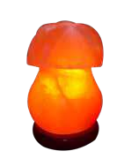
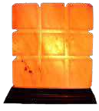
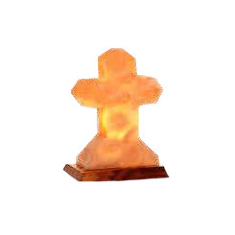
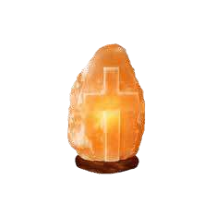

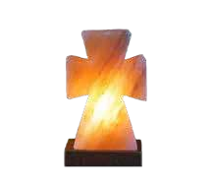
Product Catalogue
Fancy Cone Lamp
House Shape Lamp
Lined Square Lamp
Sun Flower Lamp
SKU: HCL - 17
SKU: HCL - 18
SKU: HCL - 19
SKU: HCL - 20
Cross Shape 1
Cross Shape 2
Cross Shape 3
Natural Cross Lamp
SKU: HCL - 21
SKU: HCL - 22
SKU: HCL - 23
SKU: HCL - 24

Slide 41
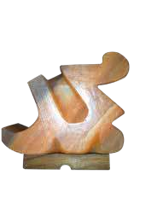
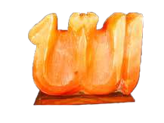
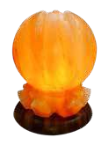
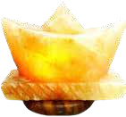
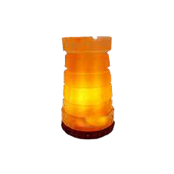
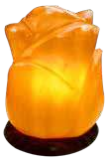

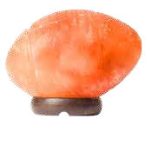
Product Catalogue
Name Of Allah
Name Of Prophet
Lotus Shape Lamp
Boat Shape Lamp
SKU: HCL - 25
SKU: HCL - 26
SKU: HCL - 27
SKU: HCL - 28
Rose Shape Lamp
Tree Shape Lamp
Base Ball Shape Lamp
Forte / Qila Lamp
SKU: HCL - 29
SKU: HCL - 30
SKU: HCL - 31
SKU: HCL - 32

Slide 42
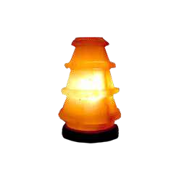
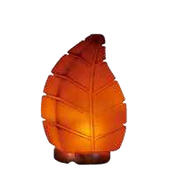
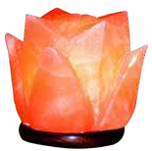
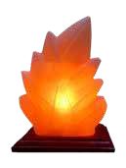




Product Catalogue
Lantern Shape Lamp
Flower Shape Lamp
Leaf Shape Lamp
Tri Leaf Shape Lamp
SKU: HCL - 33
SKU: HCL - 34
SKU: HCL - 35
SKU: HCL - 36
Wall Shape Lamp
Chinese Money Lamp
Foot Ball Shape Lamp
Palm Shape Lamp
SKU: HCL - 37
SKU: HCL - 38
SKU: HCL - 39
SKU: HCL - 40

Slide 43








Product Catalogue
Dollar Shape Lamp
Nest With Birds Lamp
Pearl Shape Lamp
Heart Shape Lamp
SKU: HCL - 41
SKU: HCL - 42
SKU: HCL - 43
SKU: HCL - 44
Lined Rectangular
Dual Illumination Round Lamp
Dual Illumination Rectangular Lamp
Sphere Shape Lamp With Wooden Base
SKU: HCL - 45
SKU: HCL - 46
SKU: HCL - 47
SKU: HCL - 48

Slide 44








Product Catalogue
3D Heart Shape Lamp
3D Merry Christmas
3D Flower Lamp
3D Tree Shape Lamp
SKU: HCL - 49
SKU: HCL - 50
SKU: HCL - 51
SKU: HCL - 52
Girl On Moon Shape Lamp
3D Sunlight Lamp
3D Cross Sign Shape
3D Floral Print
SKU: HCL - 53
SKU: HCL - 54
SKU: HCL - 55
SKU: HCL - 56

Slide 45

Product Catalogue
Aura Animal Shape Lamps
Illuminate Your World wth Himalayan Creatures

Slide 46








Product Catalogue
Eagle Shape Lamp
Dolphin Shape Lamp
Elephant Shape Lamp
Swan Shape Lamp
SKU: ASL - 01
SKU: ASL - 02
SKU: ASL - 03
SKU: ASL - 04
Cat Shape Lamp
Camel Shape Lamp
Rabbit Shape Lamp
Bear Shape Lamp
SKU: ASL - 05
SKU: ASL - 06
SKU: ASL - 07
SKU: ASL - 08

Slide 47








Product Catalogue
Horse Head Lamp
Lion Shape Lamp
Bull Shape Lamp
Owl Shape Lamp
SKU: HCL - 09
SKU: HCL - 10
SKU: HCL - 11
SKU: HCL - 12
Fish Shape Lamp
Rabbit Shape Lamp 2
Turtle Shape Lamp
Hen Shape Lamp
SKU: HCL - 13
SKU: HCL - 14
SKU: HCL - 15
SKU: HCL - 16
Page 001

Slide 48

aura Wooden & Iron Baskets
Light up your life with the calming energy of aura Natural Lamps
Product Catalogue

Slide 49








Product Catalogue
Wooden Flower Basket
Wooden Bowl Shape Basket
Wooden Round Cage
Wooden Bamboo Basket
SKU: WBL - 01
SKU: WBL - 02
SKU: WBL - 03
SKU: WBL - 04
Wooden Pillar Basket
Wooden Square Basket
Iron Round Shape Basket
Iron Round Rod Basket
SKU: WBL - 05
SKU: WBL - 06
SKU: IBL - 01
SKU: IBL - 02

Slide 50








Product Catalogue
Iron Vase Shape Basket
Iron Grill Shape Basket
Iron Flower Work Basket
Iron Sqaure Wire Basket
SKU: IBL - 03
SKU: IBL - 04
SKU: IBL - 05
SKU: IBL - 06
Iron Round Wire Basket
Iron Half Cut Shape Basket
Antique Shape Basket
Square Shape Iron Basket
SKU: IBL - 07
SKU: IBL - 08
SKU: IBL - 09
SKU: IBL - 10

Slide 51

Product Catalogue
Aura Fire Bowls
Lamps
Illuminate your surroundings and relax with Aura
Fire Bowls.

Slide 52








Product Catalogue
Fire Bowl With Chunks
Fire Bowl With Round Balls
Fire Bowl With Heart Shape
Bowl With Square Cubes
SKU: FBL - 01
SKU: FBL - 02
SKU: FBL - 03
SKU: FBL - 04
Square Bowl With Chunks
Flower Bowl With Chunks
Natural Round Bowl
Fire Bowl Crafted Design
SKU: FBL - 05
SKU: FBL - 06
SKU: FBL - 07
SKU: FBL - 08

Slide 53




Product Catalogue
Vase Shape With Chunks
Fire Bowl Crafted Design
Fire Bowl In Square Funnel
Rose Flower Fire Bowl
SKU: FBL - 09
SKU: FBL - 10
SKU: FBL - 11
SKU: FBL - 12

Slide 54

Product Catalogue
AURA White Salt
Lamps
Light up your life with the calming energy of
Aura Natural Lamps

Slide 55








Product Catalogue
Rose Flower Lamp
Rectangle Shape Lamp
Cube Shape Lamp
Pyramid Shape Lamp
SKU: WSL - 01
SKU: WSL - 02
SKU: WSL - 03
SKU: WSL - 04
Sphere Shape Lamp
Moon Shape Lamp
Leaf Shape Lamp
Heart Shape Lamp
SKU: WSL - 05
SKU: WSL - 06
SKU: WSL - 07
SKU: WSL - 08
Page 001

Slide 56








Product Catalogue
Natural White Salt Lamp
Heart Shape White Lamp
Fire Bowl With Chunks
Cylinder White Salt Lamp
SKU: WSL - 09
SKU: WSL - 10
SKU: WSL - 11
SKU: WSL - 12
Diamond Shape Salt Lamp
Tear Drop Salt Lamp
Natural Aroma Oil Burner
Cylinder Aroma Oil Burner
SKU: WSL - 13
SKU: WSL - 14
SKU: WSL - 15
SKU: WSL - 16
Page 001

Slide 57








Product Catalogue
Sphere Salt USB Lamp
Tear Drop USB Lamp
Cube Shape USB Lamp
Pyramid Shape Lamp
SKU: WSL - 17
SKU: WSL - 18
SKU: WSL - 19
SKU: WSL - 20
Natural Candle Holder
Star Shape Candle Holder
Round Candle Holder
Cube Shape Candle Holder
SKU: WSL - 21
SKU: WSL - 22
SKU: WSL - 23
SKU: WSL - 24

Slide 58

Aura Grey Salt Lamps
Product Catalogue
Create a cozy atmosphere with the warm, inviting glow of a
Aura gray salt lamp.

Slide 59








Product Catalogue
Flame Shape Lamp
Natural Grey Lamp
Pyramid Shape Lamp
Cube Shape Lamp
SKU: GSL - 01
SKU: GSL - 02
SKU: GSL - 03
SKU: GSL - 04
Ball Shape Grey Lamp
Moon Shape Lamp
Grey Heart Tea Light
Tear Drop Salt
SKU: GSL - 05
SKU: GSL - 06
SKU: GSL - 07
SKU: GSL - 08

Slide 60







Electric Fittings
Product Catalogue
USA 110 Volt Dimmer
USA 110 Volt On/Off
AUS/NZ 230 Volt On/Off
07 Volt Bulb
SKU: EF - 01
SKU: EF - 02
SKU: EF - 03
SKU: EF - 04
EU/Pakistan 2 Plug Pin 220 Volt
Dubai/UK 3 Plug Pin 22O Volt
Eu/Pakistan Dimmer 2 Plug Pin 220 Volt
25 Volt Bulb
SKU: EF - 05
SKU: EF - 06
SKU: EF - 07
SKU: EF - 08

Slide 61

aura USB Salt Lamps
Product Catalogue
Brighten your workspace, lighten your mood – USB salt lamps offer a serene escape right
at your desk

Slide 62








Product Catalogue
USB Natural Lamp
USB Sphere Lamp
USB Hexagon Lamp
USB Pyramid Lamp
SKU: USB - 01
SKU: USB - 02
SKU: USB - 03
SKU: USB - 04
USB Leaf Lamp
USB Egg Lamp
USB Moon Lamp
USB Heart Lamp
SKU: USB - 05
SKU: USB - 06
SKU: USB - 07
SKU: USB - 08

Slide 63








Product Catalogue
USB Foot Ball Lamp
USB Square Lamp
USB Tower Lamp
USB Swan Lamp
SKU: USB - 09
SKU: USB - 10
SKU: USB - 11
SKU: USB - 12
USB Dolphin Lamp
USB Elephant Lamp
USB Owl Lamp
USB Horse Head Lamp
SKU: USB - 13
SKU: USB - 14
SKU: USB - 15
SKU: USB - 16

Slide 64








Product Catalogue
USB Fish Lamp
USB Rabbit Lamp
USB Eagle Lamp
USB Camel Lamp
SKU: USB - 17
SKU: USB - 18
SKU: USB - 19
SKU: USB - 20
USB Bull Fighter Lamp
USB Tri Leaf Lamp
USB Christmas Tree
USB Cone Lamp
SKU: USB - 21
SKU: USB - 22
SKU: USB - 23
SKU: USB - 24

Slide 65








Product Catalogue
USB Forte Lamp
USB Lantern Lamp
USB Wall Lamp
USB House Lamp
SKU: USB - 25
SKU: USB - 26
SKU: USB - 27
SKU: USB - 28
USB Dollar Lamp
USB Flower Lamp
USB Lilly Flower Lamp
USB Lotus Lamp
SKU: USB - 29
SKU: USB - 30
SKU: USB - 31
SKU: USB - 32

Slide 66








Product Catalogue
USB Mushroom Lamp
USB Vase Lamp
USB Surahi Lamp
USB Cylinder Lamp
SKU: USB - 33
SKU: USB - 34
SKU: USB - 35
SKU: USB - 36
USB Heart Lamp
USB Half Cut Lamp
USB Tear Drop Lamp
USB Lined Square
SKU: USB - 37
SKU: USB - 38
SKU: USB - 39
SKU: USB - 40

Slide 67

Product Catalogue
AURA Night Light Lamps
As the sun sets, the Aura
awaken with their own
luminous charm.

Slide 68








Aura Night-Lights
Product Catalogue
Round Night Light
Heart Night Light
Natural Night Light
Egg Night Light
SKU: NLL - 01
SKU: NLL - 02
SKU: NLL - 03
SKU: NLL - 04
Tower Night Light
Glass Night Light
Octagon Night Light
Heart Night Light
SKU: NLL - 06
SKU: NLL - 07
SKU: NLL - 08
SKU: NLL - 09

Slide 69







aura Wooden Night-Lights
Product Catalogue
Horizontal Round Cage
Square Basket
Cylinder Wooden Light
Cylinder With Holes
SKU: WNL - 01
SKU: WNL - 02
SKU: WNL - 03
SKU: WNL - 04
Octagon Night Light
Vertical Round Cage
Bowl Night Light
Square Night Light
SKU: WNL - 05
SKU: WNL - 06
SKU: WNL - 07
SKU: WNL - 08
Page 001

Slide 70

Product Catalogue
Aura Tea Lights Candle Holder
Light up your life with the calming energy of Aura Natural Lamps

Slide 71








Candle Holders
Product Catalogue
Tea Light Leaf
Tea Light Eye Shape
Tea Light Heart
Tea Light 2 Hole Heart
SKU: TLC - 01
SKU: TLC - 02
SKU: TLC - 03
SKU: TLC - 04
Tea Light Natural
Tea Light 3 Hole Natural
Tea Light Ying Yang
Tea Light Diamond
SKU: TLC - 05
SKU: TLC - 06
SKU: TLC - 07
SKU: TLC - 08

Slide 72








Product Catalogue
Tea Light Flower
Heart Shape Three Hole
Round Curve 4 Hole
Round Curve 2 Hole
SKU: TLC - 09
SKU: TLC - 10
SKU: TLC - 11
SKU: TLC - 12
Rectangular 2 Hole
Star Shape Tea Light
Square Shape One Hole
Rectangular Shape 2 Hole
SKU: TLC - 13
SKU: TLC - 14
SKU: TLC - 15
SKU: TLC - 16

Slide 73








Product Catalogue
Rectangular Shape 3 Hole
Tea Light Round Shape
Triangle Tea Light
Tea Light Leaf Shape
SKU: TLC - 17
SKU: TLC - 18
SKU: TLC - 19
SKU: TLC - 20
Tea Light Swan Shape
Tea Light 3 Hole Natural
Wind Mill Tea Light
Tea Light Double Heart
SKU: TLC - 21
SKU: TLC - 22
SKU: TLC - 23
SKU: TLC - 24

Slide 74






Aroma Oil Diffuser
Product Catalogue
Cube With Dish Oil Burner
Natural Shape Small Burner
Natural Shape Medium Burner
SKU: AOD - 01
SKU: AOD - 02
SKU: AOD - 03
Natural Shape Small Burner
Natural Shape Small Burner
Natural Shape Medium Burner
SKU: AOD - 04
SKU: AOD - 05
SKU: AOD - 06

Slide 75








Iron Candle Holders
Product Catalogue
Sunflower Candle Holder
Girl Shape Candle Holder
Abstract 2 Candle Holder
Cone Shape Candle Holder
SKU: ICH - 01
SKU: ICH - 02
SKU: ICH - 03
SKU: ICH - 04
Half D Shape Candle Holder
Cup Shape Candle Holder
Tea Light Biggle Stand
Tea Light Heart Stand
SKU: ICH - 05
SKU: ICH - 06
SKU: ICH - 07
SKU: ICH - 08

Slide 76

Health And Wellness
Product Catalogue
Packed with essential minerals like calcium, potassium, and magnesium, it offers a natural alternative to traditional table salt. Beyond its culinary uses, Aura is embraced in wellness practices such as salt therapy and detoxification rituals. With its ability to balance
electrolytes and enhance hydration, Himalayan salt emerges as a versatile tool for promoting overall health and vitality.

Slide 77

Aura
Massage Stones
Infuse Your Body with Natural Wellness Of aura Massage Stones
Product Catalogue

Slide 78








Massage Stones
Product Catalogue
Salt Deodorant stick
Salt Heart Massage Stone
Imperial Massage stone
Cone Shape Candle Holder
SKU: MS - 01
SKU: MS - 02
SKU: MS - 03
SKU: MS - 04
Round Balls With Wooden
Leaf Shape Massage Stone
Massage Roller Stone
Salt Massage Wand
SKU: MS - 05
SKU: MS - 06
SKU: MS - 07
SKU: MS - 08

Slide 79








Massage Stones
Product Catalogue
Salt Heel Scraper
Coin Massage Stone
Rods For Underarm
Oval Massage Stone
SKU: MS - 09
SKU: MS - 10
SKU: MS - 11
SKU: MS - 12
Face Massage Stone
Round Massage Ball Stone
Rectangle Stone
Roller With Wooden Handle
SKU: MS - 13
SKU: MS - 14
SKU: MS - 15
SKU: MS - 16
Page 001

Slide 80








Foot Detoxers
Product Catalogue
Half Dome Foot Detoxer
Leaf Feet Detox Plate
Feet Detox Plate
Rectangular Board Line
SKU: FD - 01
SKU: FD - 02
SKU: FD - 03
SKU: FD - 04
Round Board Line
Rectangular Plain Board
Relaxus Himalayan Salt Detox
Round Plain Board
SKU: FD - 05
SKU: FD - 06
SKU: FD - 07
SKU: FD - 08

Slide 81








Pillow Therapy Bags
Product Catalogue
Salt Large Body Pillow
Eye Pillow Therapy
Neck Pillow Therapy
Back Small Therapy Pillow
SKU: PTB - 01
SKU: PTB - 02
SKU: PTB - 03
SKU: PTB - 04
Back Pillow Therapy Bag
Back Round Pillow Therapy
Spinal Therapy & Back Joint
Neck Pillow Therapy
SKU: PTB - 05
SKU: PTB - 06
SKU: PTB - 07
SKU: PTB - 08

Slide 82


Aura In haler
Product Catalogue
Using a Himalayan salt neti pot offers potential benefits for nasal health by cleansing the nasal passages, reducing inflammation, and maintaining moisture balance. The saline solution with added Himalayan salt helps to flush out mucus, allergens, and irritants, while the salt's minerals can soothe and protect nasal
Neti Pots
500 Grams
SKU: HSI - 01
tissues. To use, simply dissolve Himalayan salt in lukewarm distilled or sterile water, pour it into the neti pot, and gently irrigate one nostril at a time, allowing the solution to flow out the
other nostril. Regular use can help alleviate congestion, improve breathing,
Himalayan Salt Inhaler
500 Grams
and support overall nasal health. However, it's important to use the neti pot correctly and consult a healthcare professional if you have any concerns.
SKU: HSI - 02

Slide 83

Product Catalogue
AURA Bath Salt
Exfoliate and Elevate with Aura Scrub

Slide 84








Product Catalogue
Flavour Name
Flavour Name
Flavour Name
Flavour Name
Peach
Coffee
Citrus
Rosemary
350 gm / 12.3 oz.
350 gm / 12.3 oz.
350 gm / 12.3 oz.
350 gm / 12.3 oz.
SKU NO : BS - 01
SKU NO : BS - 02
SKU NO : BS - 03
SKU NO : BS - 04
Flavour Name
Flavour Name
Flavour Name
Flavour Name
Green Apple
Natural
Lavender
Guava
350 gm / 12.3 oz.
350 gm / 12.3 oz.
350 gm / 12.3 oz.
350 gm / 12.3 oz.
SKU NO : BS - 05
SKU NO : BS - 06
SKU NO # BS - 07
SKU NO # BS - 08

Slide 85


AURA Body Scrub
Exfoliate and Elevate with AURA Scrub
Product Catalogue

Slide 86








Product Catalogue
Flavour Name
Flavour Name
Flavour Name
Flavour Name
Coconut
Coffee
Citrus
Rosemary
350 gm / 12.3 oz.
350 gm / 12.3 oz.
350 gm / 12.3 oz.
350 gm / 12.3 oz.
SKU NO # BS - 11
SKU NO # BS - 12
SKU NO # BS - 13
SKU NO # BS - 14
Flavour Name
Flavour Name
Flavour Name
Flavour Name
Green Apple
Natural
Lavender
Blue Mint
350 gm / 12.3 oz.
350 gm / 12.3 oz.
350 gm / 12.3 oz.
350 gm / 12.3 oz.
SKU NO # BS - 15
SKU NO # BS - 16
SKU NO # BS - 17
SKU NO # BS - 18

Slide 87

AURA Kitchen Products
Product Catalogue
Experience the pure essence of the AURA in your kitchen with our exquisite range of AURA kitchen products. Crafted from ancient mineral-rich salt deposits, our
collection includes salt blocks, salt plates, salt bowls, and salt glasses, each offering a unique touch of flavor and style to your culinary adventures.

Slide 88
Kitchen Products
Cook with the Essence of the AURA’s Products
Product Catalogue
Page 001

Slide 89


AURA Salt Cooking Slab
Product Catalogue
With Holders
PRODUCT DETAIL
Aura
Salt Slab
With Stainless Steel Holder
8 X 8 X 1.5 Inch
SKU: CSS - 01
8 X 8 X 2 Inch
SKU: CSS - 02
12 X 8 X 1.5 Inch
SKU: CSS - 03
12 X 8 X 2 Inch
SKU: CSS - 04
PRODUCT DETAIL
Aura
Salt Slab With Black
Metal Holder
8 X 8 X 1.5 Inch
SKU: BMS - 01
8 X 8 X 2 Inch
SKU: BMS - 02
12 X 8 X 1.5 Inch
SKU: BMS - 03
12 X 8 X 2 Inch
SKU: BMS - 04
Page 001

Slide 90


Himalayan Salt Cooking Slab
Product Catalogue
With Holders
PRODUCT DETAIL
Himalayan Salt Slab With SS
Plate Holder
8 X 8 X 1.5 Inch
SKU: SSP - 01
8 X 8 X 2 Inch
SKU: SSP - 02
12 X 8 X 1.5 Inch
SKU: SSP - 03
12 X 8 X 2 Inch
SKU: SSP - 04
PRODUCT DETAIL
Himalayan
Salt Slab
With Wooden Holder For
Serving
8 X 8 X 1.5 Inch
SKU: SWH - 01
8 X 8 X 2 Inch
SKU: SWH - 02
12 X 8 X 1.5 Inch
SKU: SWH - 03
12 X 8 X 2 Inch
SKU: SWH - 04

Slide 91


Himalayan Salt Cooking Slab
Product Catalogue
PRODUCT DETAIL
8 X 8 X 1 Inch
SKU: CSS - 01
8 X 8 X 2 Inch
SKU: CSS - 02
Himalayan Cooking
Square Shape
Slab
10 X 10 X 2 Inch
SKU: CSS - 03
8 X 8 X 1.5 Inch
SKU: CSS - 04
10 X 10 X 1.5 Inch
SKU: CSS - 05
PRODUCT DETAIL
8 X 8 X 1 Inch
SKU: RSS - 01
8 X 8 X 2 Inch
SKU: RSS - 02
Himalayan Cooking
Round Shape
Slab
10 X 10 X 2 Inch
SKU: RSS - 03
8 X 8 X 1.5 Inch
SKU: RSS - 04
10 X 10 X 1.5 Inch
SKU: RSS - 05

Slide 92


AURA Salt Cooking Slab
Product Catalogue
PRODUCT DETAIL
Aura Cooking
Rectangular
Slab
2 X 6 X 8 Inch
SKU: CRS - 01
2 X 6 X 10 Inch
SKU: CRS - 02
12 X 8 X 1.5 Inch
SKU: CRS - 03
12 X 8 X 2 Inch
SKU: CRS - 04
PRODUCT DETAIL
Aura Cooking
Oval Shape
Slab
12 X 8 X 1.5 Inch
SKU: COS - 01
12 X 8 X 2 Inch
SKU: COS - 02

Slide 93


AURA Serving Plate & Bowl
Product Catalogue
PRODUCT DETAIL
Aura Serving
Bowl
6 X 6 X 4 Inch
SKU: HSB - 01
7 X 7 X 4 Inch
SKU: HSB - 02
8 X 8 X 4 Inch
SKU: HSB - 03
PRODUCT DETAIL
Aura Serving
Plate
6 X 6 X 1.5 Inch
SKU: HSP - 01
7 X 7 X 1.5 Inch
SKU: HSP - 02
8 X 8 X 1.5 Inch
SKU: HSP - 03

Slide 94


aura Serving Plate & Bowl
Product Catalogue
PRODUCT DETAIL
Aura Serving
Thin Plate
6 X 6 X 1.5 Inch
SKU: STP - 01
7 X 7 X 2.5 Inch
SKU: STP - 02
8 X 8 X 2.5 Inch
SKU: STP - 03
PRODUCT DETAIL
Aura Serving
Depth Bowl
6 X 6 X 2.5 Inch
SKU: SDB - 01
7 X 7 X 1.5 Inch
SKU: SDB - 02
8 X 8 X 1.5 Inch
SKU: SDB - 03

Slide 95


Mortal Pestles & Candy Jars
Product Catalogue
PRODUCT DETAIL
Aura Mortal
Pestle
6 X 6 X 2.5 Inch
SKU: HMP - 01
7 X 7 X 2.5 Inch
SKU: HMP - 02
8 X 8 X 2.5 Inch
SKU: HMP - 03
PRODUCT DETAIL
Aura Candy Jars
4 X 4 X 5 Inch
SKU: HCJ - 01
4 X 4 X 6 Inch
SKU: HCJ - 02
5 X 5 X 7 Inch
SKU: HCJ - 03

Slide 96

Mortal Pestles & Candy Jars
Product Catalogue
PRODUCT DETAIL
Aura Serving
Thin Plate
6 X 6 X 2.5 Inch
SKU: HST - 01
7 X 7 X 2.5 Inch
SKU: HST - 02
8 X 8 X 2.5 Inch
SKU: HST - 03
Page 001

Slide 97


Urn For Funerals
Product Catalogue
PRODUCT DETAIL
Aura
Biodegradable
Urn
5 X 5 X 8 Inch
SKU: HBU - 01
6 X 6 X 10 Inch
SKU: HBU - 02
8 X 8 X 12 Inch
SKU: HBU - 03
PRODUCT DETAIL
Aura
Cylinder
Urn
5 X 5 X 8 Inch
SKU: HCU - 01
6 X 6 X 10 Inch 8 X 8 X 12 Inch
SKU: HCU - 02 SKU: HCU - 03
Page 001

Slide 98


Urn For Funerals
Product Catalogue
PRODUCT DETAIL
5 X 5 X 8 Inch
SKU: HNU - 01
6 X 6 X 10 Inch 8 X 8 X 12 Inch
SKU: HNU - 02 SKU: HNU - 03
Aura
Natural Shape
Urn
PRODUCT DETAIL
Aura
Round Shape
Urn
5 X 5 X 8 Inch
SKU: HRU - 01
6 X 6 X 10 Inch
SKU: HRU - 02
8 X 8 X 12 Inch
SKU: HRU - 03

Slide 99


aura Salt Tequila Glass
Product Catalogue
PRODUCT DETAIL
Aura
Tequila
Glass
2 X 2 X 3 Inch
SKU: STG - 01
PRODUCT DETAIL
Aura
Royal
Glass
SKU: SRG - 01

Slide 100


aura Salt Tequila Glass
Product Catalogue
PRODUCT DETAIL
Aura
2 set Tequila
Glassz
SKU: STG - 01 (2PC)
PRODUCT DETAIL
Aura
6 set Tequila
Glass
SKU: SRG - 02 (6PC)
Page 001

Slide 101


aura Salt Tequila Glass
Product Catalogue
PRODUCT DETAIL
Aura
2 Set Wine
Glass
SKU: SWG - 01 ( 2PC)
PRODUCT DETAIL
Aura
6 set Wine
Glass
SKU: SWG - 02 (6PC)

Slide 102


aura Salt Tequila Glass
Product Catalogue
PRODUCT DETAIL
Aura
2 set
Wood Tequila Glass
SKU: SWG - 01 (2PC)
PRODUCT DETAIL
Aura
6 set
Wood Tequila
Glass
SKU: SWG - 02 (6PC)

Slide 103


Stick & Stones For Grating
Product Catalogue
PRODUCT DETAIL
Aura
Cube For
Grating
1 X 1 X 1
SKU: HSC - 01
2 X 2 X 2
SKU: HSC - 01
PRODUCT DETAIL
Aura
Sticks For
Grating
1 X 1 X 1
SKU: HSS - 01
2 X 2 X 2
SKU: HSS - 01

Slide 104

Stick & Stones For Grating
Product Catalogue
PRODUCT DETAIL
Aura
Salt Chunks For Grating
500 gm
SKU: SCG - 01

Slide 105

Aura Animal Lick Salt Products
Product Catalogue
Aura animal lick salt provides essential minerals like sodium and potassium for livestock.
These natural mineral blocks are believed to promote hydration, aid digestion, and support overall health. Placed in pastures or enclosures, animals can access them freely. However, monitoring
consumption is crucial to prevent overindulgence, as excessive salt intake can be harmful.ever,
it's essential to monitor animals' consumption to prevent overconsumption, as excessive salt intake can be harmful.

Slide 106






Product Catalogue
Animal Licking Cube Shape
1-2 kg, 2-3 kg, 3-5 kg
Animal Cylinder Salt
1-2 kg, 2-3 kg, 3-5 kg
Animal Salt With Rope
1-2 kg, 2-3 kg, 3-5 kg
Animal Hanging Salt
1-2 kg, 2-3 kg, 3-5 kg
Animal Compressed Salt
1-2 kg, 2-3 kg, 3-5 kg
Animal Rock Salt
1 - 10 kg

Slide 107

aura Construction Products
Product Catalogue
Experience the pure essence of the Aura’s in your kitchen with our exquisite range of Aura kitchen products. Crafted from ancient mineral-rich salt deposits,
our collection includes salt blocks, salt plates, salt bowls, and salt glasses, each offering a unique touch of flavor and style to your culinary adventures.

Slide 108







aura Construction Bricks
Product Catalogue
Rectangular Bricks
8 X 4 X 1 Inches
Rectangular Bricks one side cut
8 X 4 X 2 Inches
Rectangular Bricks Plain
8 X 4 X 2 Inches
Rectangular Brick
8 X 4 X 1.5 Inches
Rectangular Brick With Buff
8 X 4 X 2 Inches
Square Brick
8 X 8 X 1 Inches

Slide 109





aura Construction Bricks
Product Catalogue
Square Bricks
8 X 8 X 1.5 Inches
Rectangular Bricks
10 X 4 X 4
Bricks & Tiles 1 Side Natural
8 X 8 X 2 Inches
Rectangular Bricks
12 X 8 X 1.5 Inches
Rectangular Bricks
10 X 4 X 2 Inches
Rectangular Bricks
12 X 4 X 4 Inches

Slide 110




Aura Construction Bricks
Product Catalogue
Bricks & Tiles 1 Side Natural
8 X 4 X 1 Inches
Bricks & Tiles 1 Side Natural
8 X 8 X 2 Inches
Bricks & Tiles 1 Side Natural
8 X 2 X 2 Inches
Salt Lump 1 Side Natural For Construction
Bricks & Tiles 1 Side Natural
8 X 8 X 1 Inches
Cut Seets Of Rock Salt

Slide 111



aura Construction Bricks
Product Catalogue
Chunks Natural Shape
Rock Salt Lumps
Granular Salt For Floor Edited
( Floor Salt)
Page 001

Slide 112


Product Catalogue
Cradled in healing comfort, experience the nourishing benefits of Aura Salt while relaxing on the heated, ultra-comfortable Flex-Block Salt Lounge. Client lays directly on our innovative flex-top surface – Aura salt tiles that cushion and give way with the body for a comfortable, cradling feeling. With remote control, the motorized lounge moves easily from upright to a soothing zero-
gravity position. Waterproof heater warms the salt tiles that release negative ions to improve respiratory and allergy issues, decrease anxiety, and more
PRODUCT DETAIL
Flex-Block Salt Lounge Chair
PRODUCT DETAIL
Flex-Block Salt Lounge Chair

Slide 113
F.A.Q’S
Product Catalogue
Q1: what is the minimum order quantity (MOQ) I can order?
A: Normally, we accept orders with a minimum quantity of 20’container load. Contact us if you are looking for less than a container load quantity.
Q2: Can I get a sample of your product?
A: Our samples are free of cost but shipping would be charged from the customer.
Q3: Where can I view your price list?
A: You can send us an email asking for price list of required products by providing your company details (name, website and contact number) and one of our marketing
representatives will get back to you with the price list.
Q4: Can you quote CNF or CIF prices?
A: We normally quote FOB Karachi prices and Ocean Freight separately but CNF and CIF prices can also be provided once we have expected order quantity and name of
destination sea port.
Q5: What are your payment terms?
A: Our payment terms are: 50% advance payment to initiate production, Balance 50% is paid against scan copies of Bill of Lading & Invoice by email. All payment transactions
through bank. Please be noted that our payment policy may vary from region to region.

Slide 114


Thank You
CONTACT US:
infoaura@gmail.com
www.aura.com
+92-3002281967
+92-3003376020

